Slide 1

Qu’est-ce que le cut-off ?
Xavier Bossuyt

Slide 2
Anti-nuclear antibodies

Slide 3
 | EliA CTD Screen | IIF 1:≥40 or SSA pattern | IIF 1:≥80 or SSA pattern | IIF 1:≥160 or SSA pattern | IIF 1:≥320 or SSA pattern | IIF 1:≥640 or SSA pattern | IIF 1:≥1280 or SSA pattern
SLE | 73.8 | 96.3 | 92.5 | 90.0 | 68.8 | 53.8 | 31.3
SSc | 72.5 | 98.6 | 97.1 | 92.8 | 81.2 | 62.3 | 39.1
MCTD | 100.0 | 100.0 | 100.0 | 100.0 | 100.0 | 92.3 | 69.2
SS | 88.9 | 91.7 | 83.3 | 55.6 | 44.4 | 41.7 | 36.1
PM/DM | 39.3 | 64.3 | 46.4 | 35.7 | 28.6 | 14.3 | 7.1
BD | 2.7 | 12.1 | 8.7 | 6.0 | 2.7 | 1.3 | 0.7
CFS | 2.9 | 14.4 | 7.9 | 3.6 | 2.9 | 2.9 | 2.9
DC | 3.7 | 35.8 | 25.4 | 17.9 | 11.2 | 6.0 | 3.0
IIF: HEp-2000
EliA CTD screen: dsDNA, SSA, SSB, RNP, Sm, CENP-B, Scl-70, Jo-1, Mi-2, RNA-PolIII, PM/SCL, Rib-P, fibrillarin
Op de Beeck et al. Autoimmun Rev. 2011

Slide 4
 | EliA CTD Screen | IIF 1:≥40 or SSA pattern | IIF 1:≥80 or SSA pattern | IIF 1:≥160 or SSA pattern | IIF 1:≥320 or SSA pattern | IIF 1:≥640 or SSA pattern | IIF 1:≥1280 or SSA pattern
SLE | 73.8 | 96.3 | 92.5 | 90.0 | 68.8 | 53.8 | 31.3
SSc | 72.5 | 98.6 | 97.1 | 92.8 | 81.2 | 62.3 | 39.1
MCTD | 100.0 | 100.0 | 100.0 | 100.0 | 100.0 | 92.3 | 69.2
SS | 88.9 | 91.7 | 83.3 | 55.6 | 44.4 | 41.7 | 36.1
PM/DM | 39.3 | 64.3 | 46.4 | 35.7 | 28.6 | 14.3 | 7.1
BD | 2.7 | 12.1 | 8.7 | 6.0 | 2.7 | 1.3 | 0.7
CFS | 2.9 | 14.4 | 7.9 | 3.6 | 2.9 | 2.9 | 2.9
DC | 3.7 | 35.8 | 25.4 | 17.9 | 11.2 | 6.0 | 3.0
IIF: HEp-2000
EliA CTD screen: dsDNA, SSA, SSB, RNP, Sm, CENP-B, Scl-70, Jo-1, Mi-2, RNA-PolIII, PM/SCL, Rib-P, fibrillarin
Op de Beeck et al. Autoimmun Rev. 2011

Slide 5
9856 unique patient samples

Slide 6
 | IIF Neg. | IIF 1:80 | IIF 1:160 | IIF 1:320 | IIF 1:640 | IIF ≥1:1280 | IIF SSA
Positive predictive values (PPV)
PPV of IIF for SLE | 0.001 | 0.010 | 0.035 | 0.058 | 0.087 | 0.118 | 0.168
PPV of IIF for AASRD |  | 0.020 | 0.069 | 0.157 | 0.344 | 0.515 | 0.541
Estimated likelihood ratios (LR)
Estimated LR of IIF for SLE | 0.096 | 1.2 | 4.1 | 7.0 | 10.9 | 15.1 | 23.0
Willems et al. Ann Rheum Dis. 2018 In press

Slide 7
 |  | Total number (male/female) | Median age (y, min-max)
AASRD (n= 480) | Systemic Lupus Erythematodes (SLE) | 119 (18/101) | 32.5 (15-72)
 | Systemic Sclerosis (SSc) | 220 (55/165) | 45 (18-85)
 | Primary Sjögren’s Syndrome (SjS) | 65 (10/55) | 49 (16-89)
 | Myositis (PM/DM) | 50 (19/31) | 50.5 (24-84)
 | Mixed Connective Tissue Disease (MCTD) | 26 (3/23) | 32 (16-66)
Controls (n= 767) | Diseased controls (DC) | 314 (76/238) | 43 (16-90)
 | Chronic fatigue syndrome (CFS) | 150 (28/122) | 41 (16-75)
 | Blood donors (BD) | 279 (146/133) | 46 (18-69)
 | Polymyalgia Rheumatica (PMR) | 6 (2/4) | 71 (58-83)
 | Rheumatoid artritis (RA) | 18 (6/12) | 48 (18-76)
Claessens et al. Autoimmun Rev. 2018

Slide 8
Claessens et al. Autoimmun Rev. 2018

Slide 9
Claessens et al. Autoimmun Rev. 2018

Slide 10
Claessens et al. Autoimmun Rev. 2018

Slide 11
Claessens et al. Autoimmun Rev. 2018

Slide 12
Claessens et al. Autoimmun Rev. 2018

Slide 13
Claessens et al. Autoimmun Rev. 2018

Slide 15
RF and ACPA

Slide 16
Rheumatoid Factor (RF, n=6)
Anti-cyclic Citrullinated Peptide
Antibodies (ACPA, n=7)
  Menarini
  Thermo Fisher
  Inova
  Roche
  Abbott
  Euroimmun
  Menarini
  Thermo Fisher
  Inova
  Roche
  Abbott
  Euroimmun
  Euro Diagnostica
  REFERENCE MATERIALS
  RF: WHO International standard W1066
  RA serum 64/002 [National Institute of Biological Standards and Control (NIBSC)].
  ACPA: CDC standard
Van Hoovels et al. Ann Rheum Dis. 2018
Notes:
Six commercial RF and seven commercial ACPA assays were included in this study.
Regarding technical performance we evaluated imprecision, linearity, limit of quantification and carry over. Due to lack of time, I can’t discuss these results, but if you are interested, please visit our poster.

Slide 17
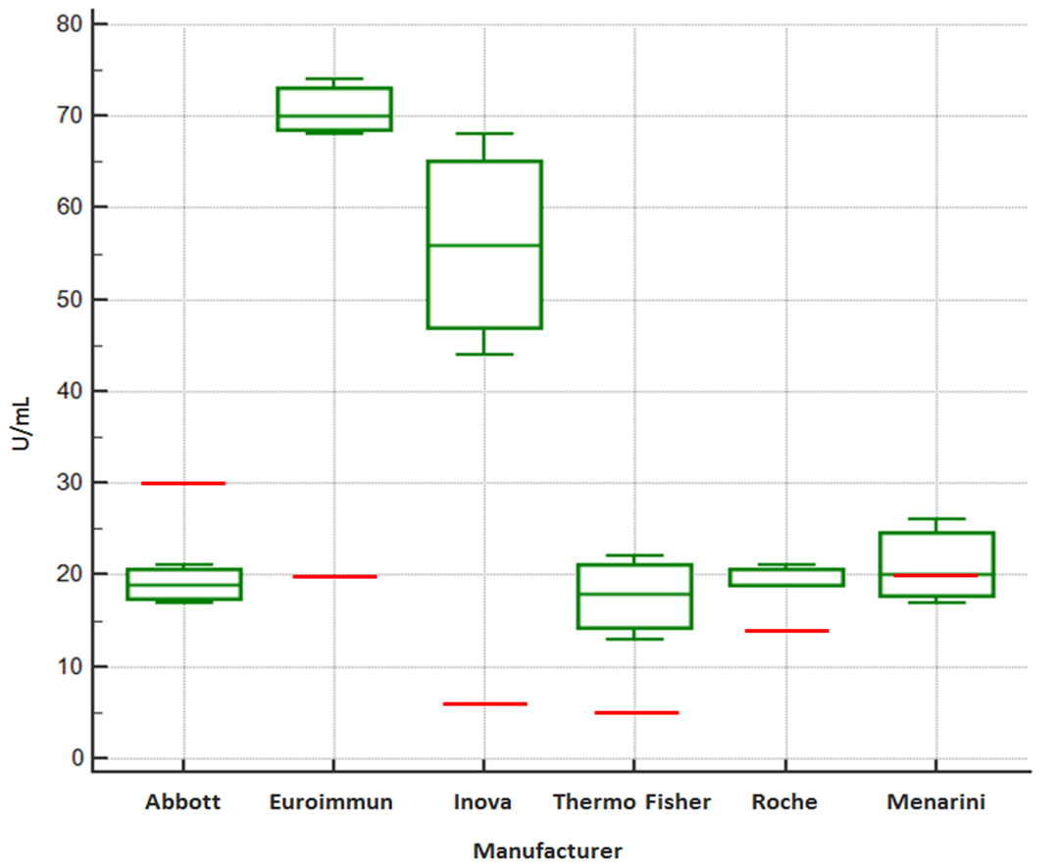
W1066 RF
= cut-off
Target value 25 IU/mL
Van Hoovels et al. Ann Rheum Dis. 2018
Notes:
With the exception of Euroimmun RF ELISA, all evaluated RF assays reported in their package insert traceability to an international RF standard (Menarini, Abbott, Thermo Fisher: W1066; Roche, Inova: British 64/002). W1066 was tested three times for RF with all assays. We found a good quantitative agreement between RF IgM assays from Menarini, Abbott, Thermo Fisher and Roche. The Inova RF IgM ELISA gave higher values (Figure 1.A). According to the manufacturer’s cutoffs, Abbott (and Menarini) RF would classify W1066 as negative.

Slide 18
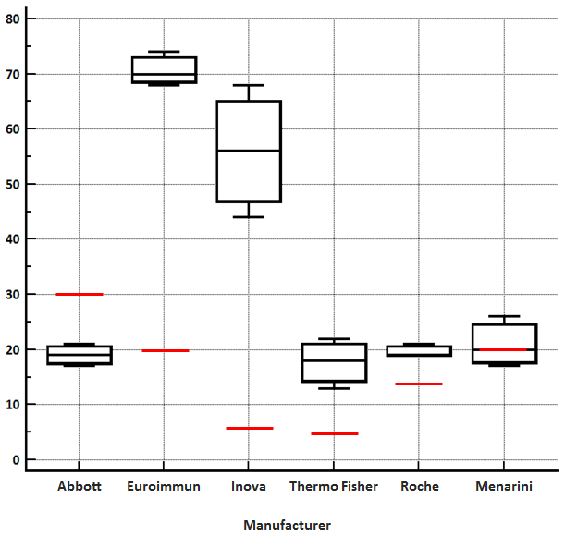
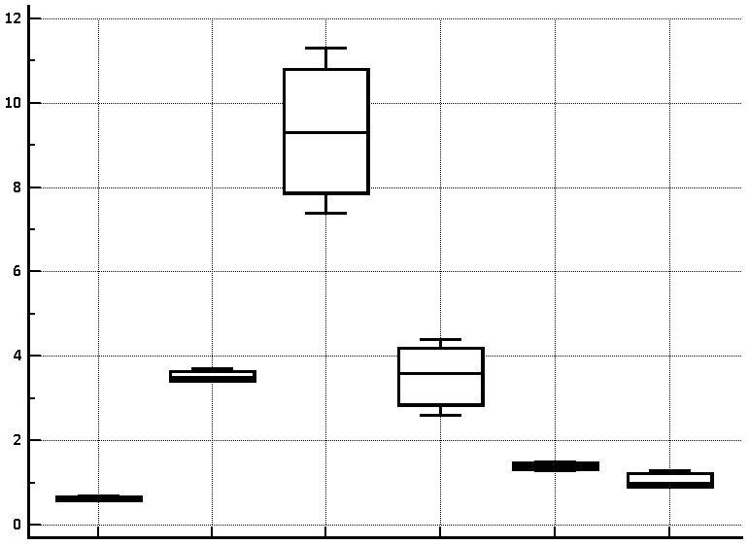
RF
A
B
RF result (manufacturer ‘s specific units)
Ratio RF result/manufacturer’s specific cutoff
Van Hoovels et al. Ann Rheum Dis. 2018

Slide 19
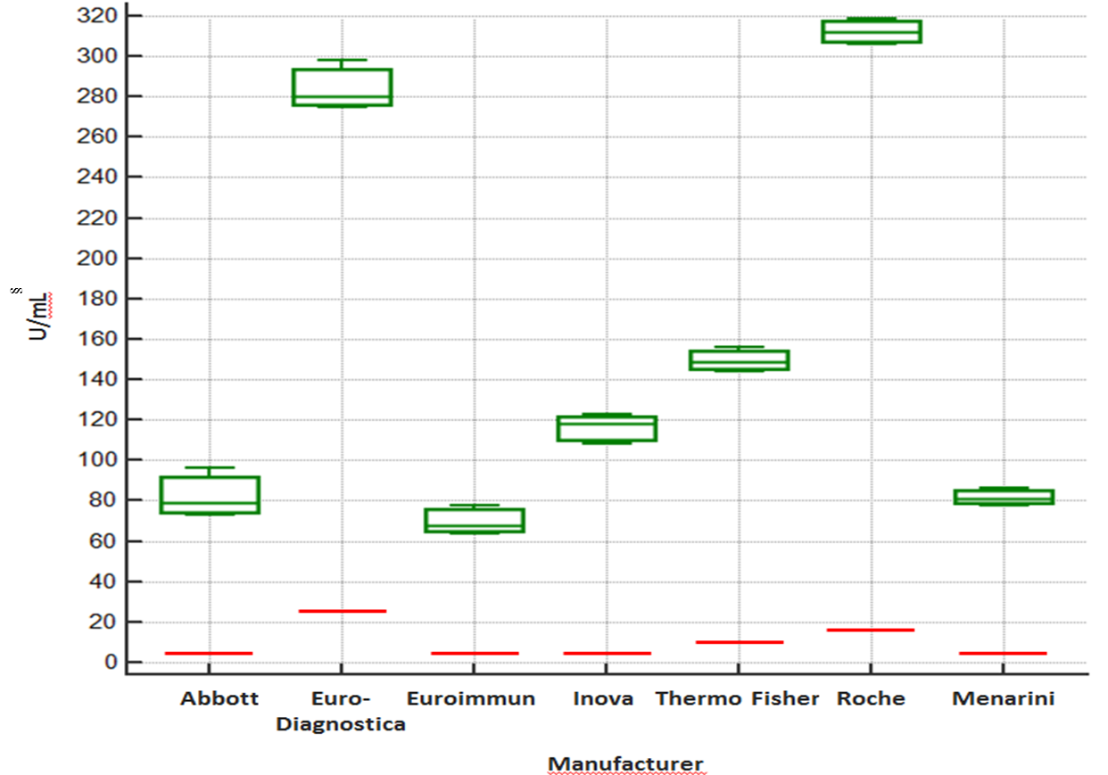
CDC reference ACPA
= cut-off
Target value 100 IU/mL
Van Hoovels et al. Ann Rheum Dis. 2018
Notes:
The CDC ACPA reference material was tested with all ACPA assays. We found large differences between numerical results obtained, with results from Euro Diagnostica and Roche being much higher than results from the other manufacturers (Figure 1.B). All assays found the CDC ACPA reference material as ‘strongly positive’ according to the ACR/EULAR criteria.

Slide 20
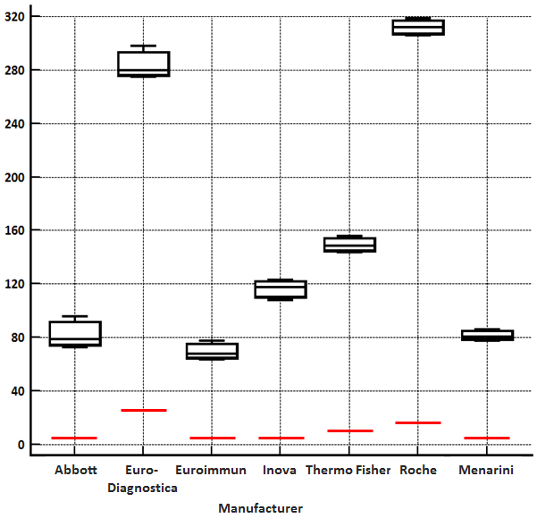
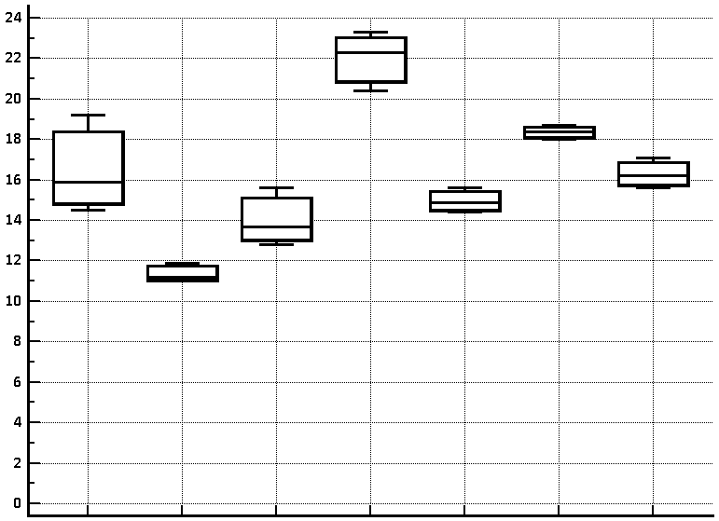
ACPA
C
D
ACPA result (manufacturer ‘s specific units)
Ratio ACPA result/manufacturer’s specific cutoff
Van Hoovels et al. Ann Rheum Dis. 2018

Slide 21
Patient samples (n=620)
Primary diagnostic rheumatological patients (n=594)
  January 2014 – June 2015 (primary diagnostic rheumatologic laboratory bilan)
  review of medical records: diagnosis + review diagnosis after 1 year
  diagnosis control + clinical categorization by rheumatologist:
      rheumatoid arthritis (RA, n=44)
          patient with synovitis
          MTX was initiated
          no alternative diagnosis could explain symptoms
      rheumatologic disease controle group (RDCG, n=247)
      disease controle group (DCG, n=225)
      undifferentiated (UNDIFF, n=78)
Extra rheumatoid arthritis patients (n=26)
  June 2012 – April 2016
Van Hoovels et al. Ann Rheum Dis. 2018
Notes:
For method comparison and diagnostic performance evaluation, we analyzed 620 patient samples with every included serological assays.
Those patients samples were retrieved from all unique patients (n=594) who between January 2014 and June 2015, for the first time underwent laboratory testing for a rheumatologic disease, requested by a rheumatologist of the Onze-Lieve-Vrouw hospital in Aalst, Belgium (a secondary care hospital).
Of those patients, electronical medical records reviewed, the diagnosis was registered and reviewed by the consulting rheumatologist. Patients were categorized into four groups: RA, rheumatologic disease control group (RDCG) and disease control group (DCG) and undifferantiated. A patient with synovitis was considered to have RA (n=44) when the treating rheumatologist initiated methotrexate treatment (if no contra-indication existed) and no alternative diagnosis could better explain the symptoms.
To enlarge the group of RA patients, 26 additional RA patients (recruited between June 2012 and April 2016) were included. These RA patients were coded as described above.
The WHO W1066 international reference serum for RF (target value of 25 IU/mL) and the CDC ACPA standard (target value 100 IU/mL) were analyzed for, respectively, RF and ACPA with all assays. The standard material was reconstituted according to the guidelines, aliquoted and measured three times in different runs[24].

Slide 22
Sensitivity / Specificity for RA
Large variation in sensitivity and specificity using manufacturer’s cutoff
Van Hoovels et al. Ann Rheum Dis. 2018
Notes:
Using the manufacturer’s cutoff, RF positivity was found in 35.7-60.0% of RA patients, associated with a specificity of 71.6-98.9%. The highest sensitivity (60.0%) and lowest specificity (71.6%) was found for Euroimmun RF. ACPA positivity was comparable between the assays and varied between 34.3% and 41.4% in RA patients and between 0.4-2.7% in controls.

Slide 23
Results
Likelihood ratio of RA
Van Hoovels et al. Ann Rheum Dis. 2018
Notes:
For all assays the likelihood of RA increased with increasing antibody levels.
Table 3 shows the LRs for RF and ACPA and a combination thereof according to the serological ACR/EULAR 2010 RA classification criteria. The LRs for RA were higher for strong positive results (>3-times cutoff) than for weak positive results (1-3 times cutoff value). Strong positive RF or ACPA results had a high LR for RA (>10), except for two RF assays (from Inova and Euroimmun). The highest LRs were consistently found for double positivity for RF and ACPA. The differences in LR between assays were less pronounced when a cutoff that is based on a pre-defined specificity was applied.

Slide 24
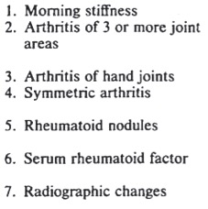
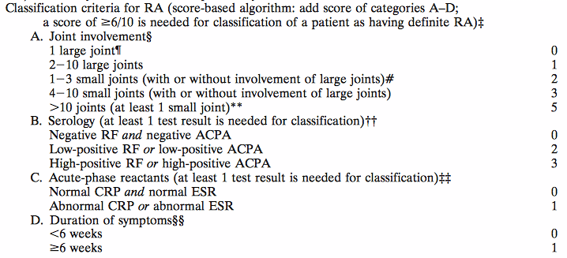
Rheumatoid arthritis
ACR 1987
ACR/EULAR 2010
≥ 4/7=RA
≥ 6/10=RA
Arnett et al. Arthritis Rheum 1988;31:315-24
Aletaha et al. Ann Rheum Dis 2010;62:2569-2581
Notes:
The American College of Rheumatology (ACR) criteria are widely used as the “gold standard” for classification of RA. Due to the lack of sensitivity of the 1987 ACR criteria[6], the ACR and the European League Against Rheumatism (EULAR) proposed new classification criteria in 2010[7]. Application of the 2010 classification criteria provides a score of 0-10, with a score ≥6 being indicative of definite RA. The presence of rheumatoid factor (RF) or anti-cyclic citrullinated protein/peptide antibodies (ACPA) contributes two points if detectable and three points if present at levels >3 times the upper limit of normal

Slide 25
Rheumatoid arthritis
ACR 1987
ACR/EULAR 2010
≤ ULN
> ULN but ≤ 3x ULN
> 3x ULN
≥ 6/10=RA
Aletaha et al. Ann Rheum Dis 2010;62:2569-2581
Notes:
The American College of Rheumatology (ACR) criteria are widely used as the “gold standard” for classification of RA. Due to the lack of sensitivity of the 1987 ACR criteria[6], the ACR and the European League Against Rheumatism (EULAR) proposed new classification criteria in 2010[7]. Application of the 2010 classification criteria provides a score of 0-10, with a score ≥6 being indicative of definite RA. The presence of rheumatoid factor (RF) or anti-cyclic citrullinated protein/peptide antibodies (ACPA) contributes two points if detectable and three points if present at levels >3 times the upper limit of normal

Slide 26
RA classification
Without RF/ACPA serology= 45.7%
With RF serology = 71.4-82.9%
= 11% difference
With ACPA serology = 70.0-71.4%
= 1% difference
With RF/ACPA serology= 77.1-84.3%
= 7% difference
Van Hoovels et al. Ann Rheum Dis. 2018
Notes:
As our study revealed differences in test results between different companies, we evaluated whether such differences could impact disease classification. All RA patients were classified according to the 2010 ACR criteria using RF and ACPA results obtained with assays from different manufacturers (Table 4). In 32 (of 70) RA patients (46%), an ACR score ≥6 was obtained based solely on clinical data (i.e. without lab data). Inflammation did not contribute to disease classification. When only RF was considered, then 50 or 58 patients fulfilled the criteria when, respectively, the least or most sensitive RF assay was considered. When only ACPA was considered, then 49 or 50 patients fulfilled the criteria when, respectively, the least or most sensitive assay was considered. When RF and ACPA were considered (by combining assays from the same manufacturer), then 54 or 59 patients fulfilled the criteria depending on the manufacturer. Thus, classification of patients using the 2010 ACR classification criteria depended on the assays used.

Slide 27
ANCA

Slide 28
Receiver operating characteristics curve for eight antigen-specific immunoassays and two IIF methods (Copenhagen and Bad Bramstedt) for ANCA detection.
Damoiseaux et al. Ann Rheum Dis 2017;76:647-653
Notes:
Receiver operating characteristics curve for eight antigen-specific immunoassays and two indirect immunofluorescence (IIF) methods (Copenhagen and Bad Bramstedt) for antineutrophil cytoplasmic antibodies (ANCA) detection. For antigen-specific immunoassays, the highest level of reactivity from the proteinase 3-ANCA and myeloperoxidase-ANCA determinations was selected for analysis. For IIF, the highest level of reactivity, independent of pattern, was selected for analysis. The immunoassays included were from Inova (QuantaLite (1) and QuantaFlash (2)), Thermo-Fisher (EliA) (3), Bio-Rad (BioPlex 2200) (4), Euro-Diagnostica (5), Orgentec (6), Euroimmun (7) and Medipan (CytoBead assay) (8). IIF was performed at Copenhagen (9) and Bad Bramstedt (10).

Slide 29
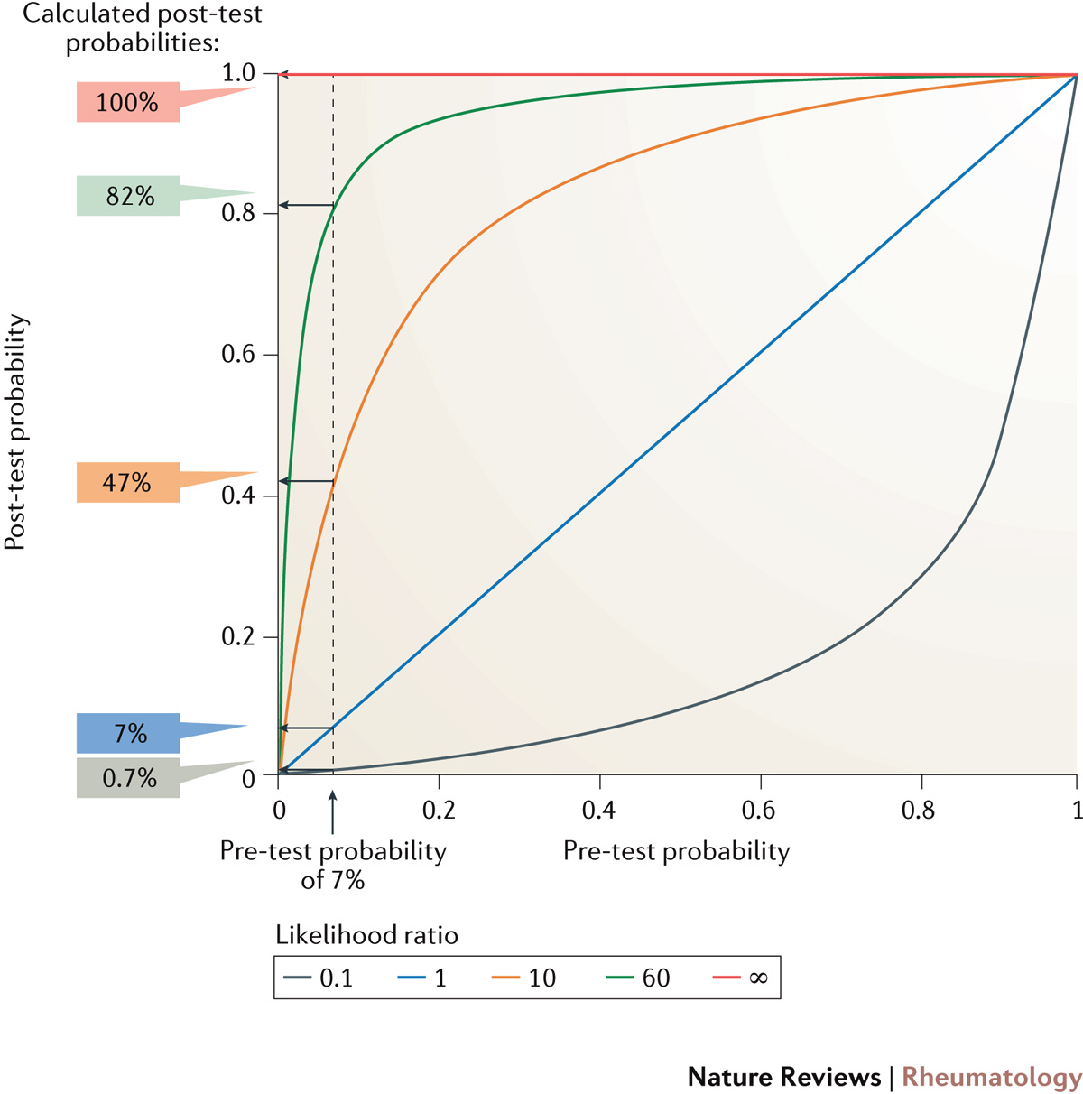
Post-test probability as a function of pre-test
probability for different test result interval-specific likelihood ratios
Bossuyt X. et al. Nat Reviews Rheumatology, 2017
Bossuyt X. et al. Rheumatology (Oxford). 2017
Notes:
Figure 4 | Post-test probability as a function of pre-test probability for different test result interval-specific likelihood ratios. The figure exemplifies how a graph can be used in practice to help in the interpretation of test results. The graph shows the post-test probability for anti-neutrophil cytoplasmic antibody (ANCA)-associated vasculitis (AAV) as a function of the pre-test probability for test results with a likelihood ratio of 0.1, 1, 10, 60 and ∞. In a previous study⁷⁸, ANCA test result intervals that have a similar spread of likelihood ratios were delimited for several commercial assays. The equations to calculate post-test probability based on pre-test probability and likelihood ratio are: post-test odds = pre-test odds x likelihood ratio; odds = probability/(1−probability); probability = odds/(1+odds). The graph shows that for a patient with a pre-test probability of AAV of 7%, the post-test probability will be 0.7%, 7%, 43%, 82% and 100% for a test result with a likelihood ratio of 0.1, 1, 10, 60 and ∞, respectively.

Slide 30
Qu’est-ce que le cut-off ?
Acknowledgments
L. Van Hoovels, J. Jacobs, B. Vander Cruyssen, P. Verschueren
P. Willems, J. Claessens, D. Blockmans, R. Westhovens, T. Belmondo, S. Hüe, M. Fritzler, K. Op de Beeck.
E. Csernok, J. Damoiseaux, JW Cohen-Tervaert, N. Rasmussen

