Slide 2
NVL = NUCLEAR VALOSIN CONTAINING PROTEIN LIKE
VCP-LIKE NUCLEAR PROTEIN
GENE CDC48, p97 Protein AAA ATPase
Mutation: SLA et Charcot-Marie-Tooth

Slide 3
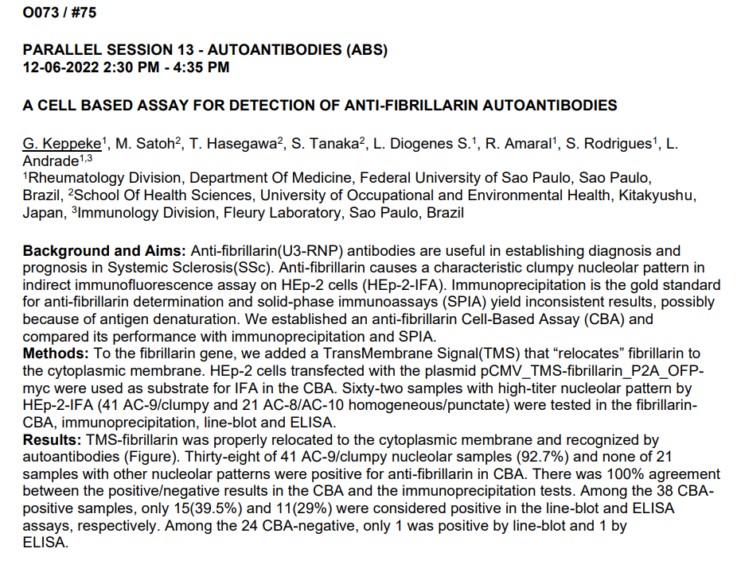

Slide 4
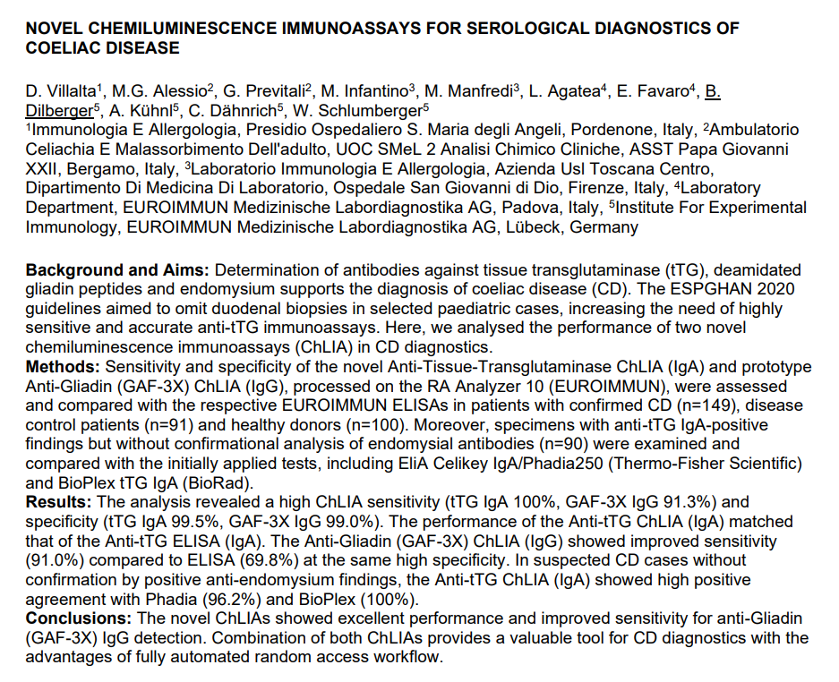

Slide 6
GLIADINE NATIVE
PEPTIDE DE GLIADINE DEAMIDEE
TRANSGLUTAMINASE 2 TISSULAIRE
TRANSGLUT 2 DPG NEO EPITOPE
TRANSGLUTAMINASE 3 EPIDERME
TRANSGLUTAMINASE MICROBIENNE + DPG NEO EPITOPE
TRANSGLUTAMINASE MICROBIENNE
GLIADINE DIGEREE PEPSINE-TRYPSINE

Slide 7
11

Slide 9
770 SAMPLES
HEPATO Target Disease Group
194 AIH
TEMOINS

Slide 10
