Slide 1
GEAI Janvier 2023
Xavier Bossuyt

Slide 3
RuvBL1/2
2
RuvB like AAA ATPase
‘ATPase Associated with diverse cellular Activities’
Hexamere: essential ATP-binding
ATPase activiteit
Chromatin remodeling
Transcription regulation
DNA repair
Chaperone activity
1
1
2
2
1

Slide 4
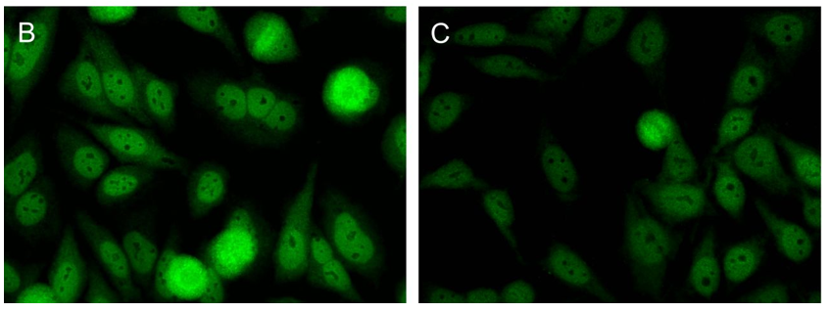
In literature:
43 cases: 24: SSc + myositis
18: SSc
1: SSc + SS
Own cases (Vulsteke et al. ARD 2022)
8 cases: 5: SSc + myositis
3: SSc

Slide 5
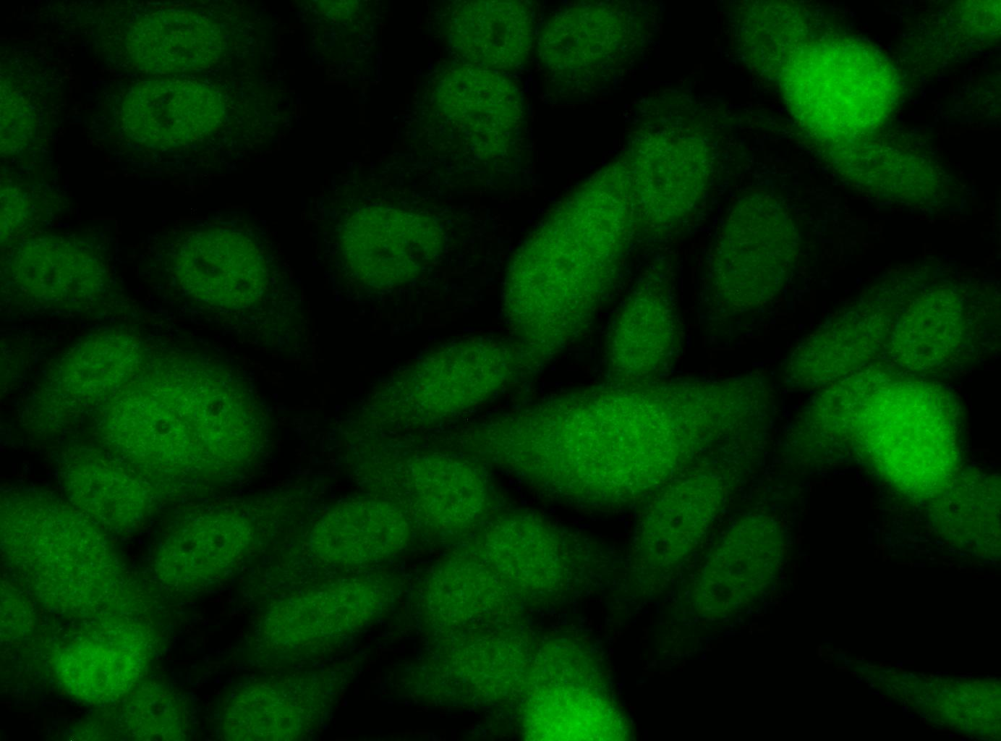
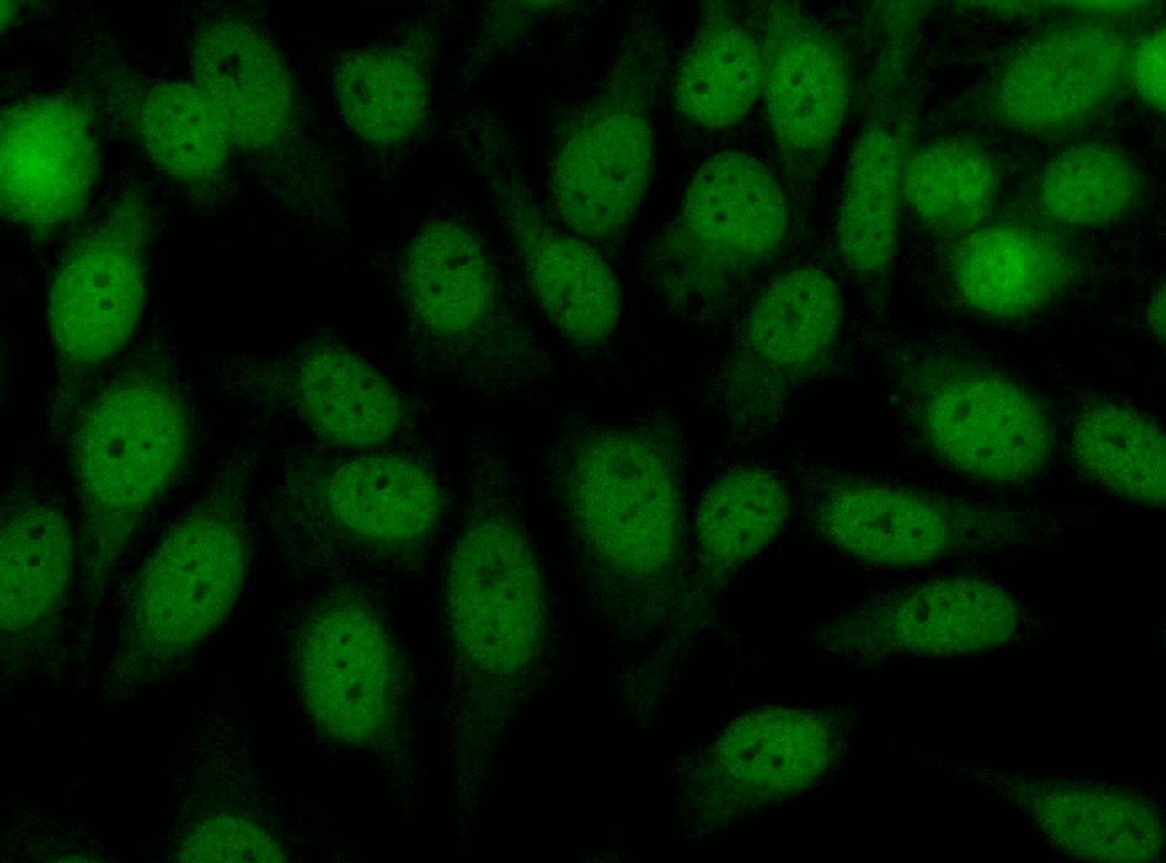
Anti-RuvBL1/2

Slide 6
Peak Intensity= Signal detected on MRM device corresponding to most intense fragment ion for a given peptide
MK IEEVK STTK TQR IASHSHVK GLGLDESGLAK QAASGLVGQENAR EACGVIVELIK SK K MAGR AVLLAGPPGTGK TALALAIAQELGSK VPFCPMVGSEVYSTEIK K TEVLMENFR R AIGLR IK ETK EVYEGEVTELTPCETENPMGGYGK TISHVIIGLK TAK GTK QLK LDPSIFESLQK ER VEAGDVIYIEANSGAVK R QGR CDTYATEFDLEAEEYVPLPK GDVHK K K EIIQDVTLHDLDVANARPQGGQDILSMMGQLMKPK K TEITDK LR GEINK VVNK YIDQGIAELVPGVLFVDEVHMLDIECFTYLHR ALESSIAPIVIFASNR GNCVIR GTEDITSPHGIPLDLLDR VMIIR TMLYTPQEMK QIIK IR AQTEGINISEEALNHLGEIGTK TTLR YSVQLLTPANLLAK INGK DSIEK EHVEEISELFYDAK SSAK ILADQQDK YMK
RuvBL1

Slide 7
MATVTATTK VPEIR DVTR IER IGAHSHIR GLGLDDALEPR QASQGMVGQLAAR R AAGVVLEMIR EGK IAGR AVLIAGQPGTGK TAIAMGMAQALGPDTPFTAIAGSEIFSLEMSK TEALTQAFR R SIGVR IK EETEIIEGEVVEIQIDRPATGTGSK VGK LTLK TTEMETIYDLGTK MIESLTK DK VQAGDVITIDK ATGK ISK LGR SFTR AR DYDAMGSQTK FVQCPDGELQK R K EVVHTVSLHEIDVINSR TQGFLALFSGDTGEIK SEVR EQINAK VAEWR EEGK AEIIPGVLFIDEVHMLDIESFSFLNR ALESDMAPVLIMATNR GITR IR GTSYQSPHGIPIDLLDR LLIVSTTPYSEK DTK QILR IR CEEEDVEMSEDAYTVLTR IGLETSLR YAIQLITAASLVCR K R K GTEVQVDDIK R VYSLFLDESR STQYMK EYQDAFLFNELK GETMDTS
RuvBL2

Slide 8
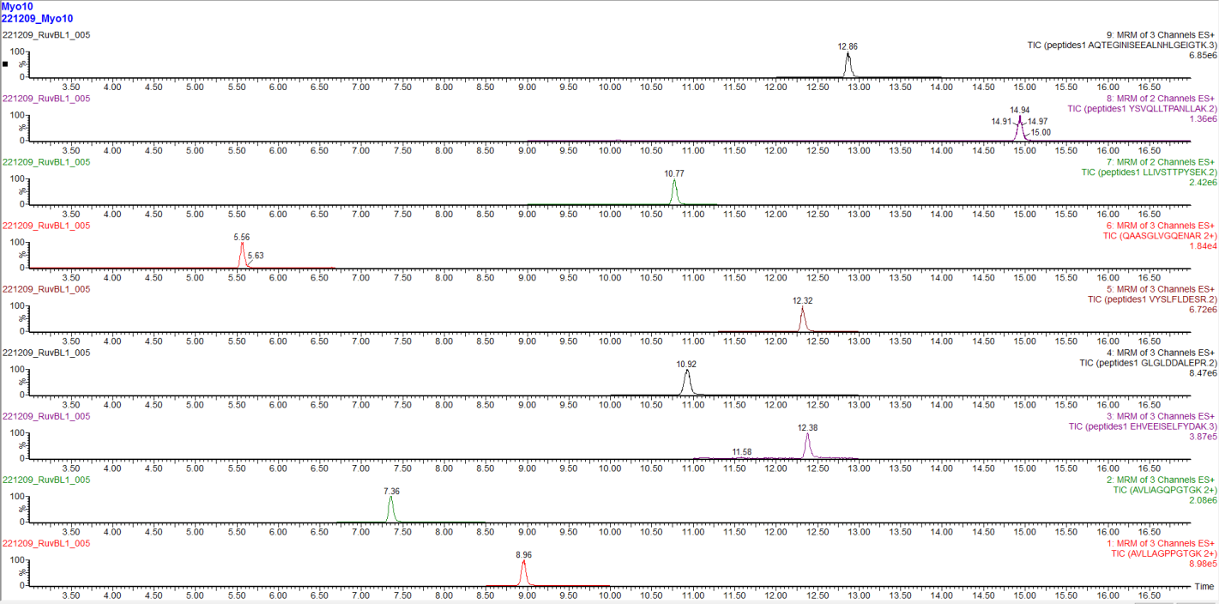
Multiplex of 9 putative RuvBL peptides
Positive sample: Myo10

Slide 9
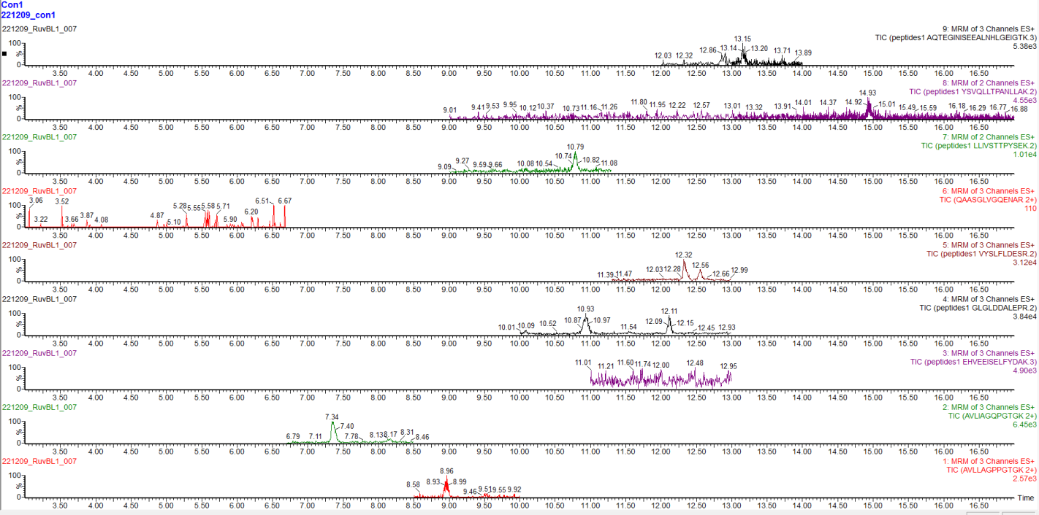
Multiplex of 9 putative RuvBL peptides
Control Sample 1

Slide 11
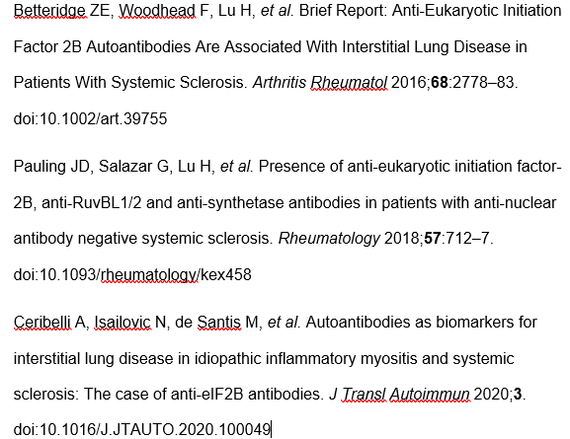
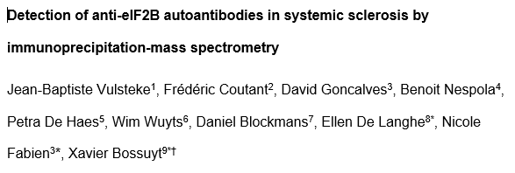
19 cases,
SSc
all cytoplasmic staining
association with ILD
6 cases
SSc
5: ILD
3: diffuse cutaneous involvment

Slide 12
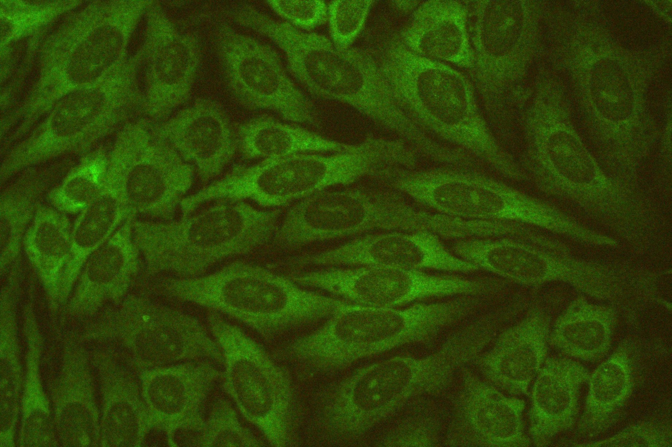
Picture: N. Fabien
Vulsteke et al. Manuscript in review

Slide 13
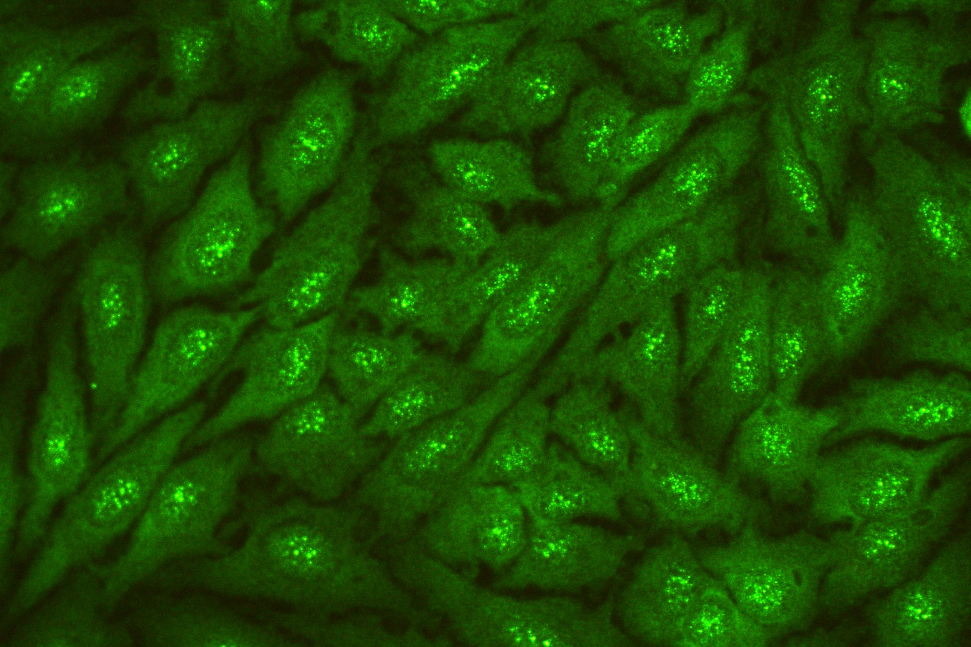
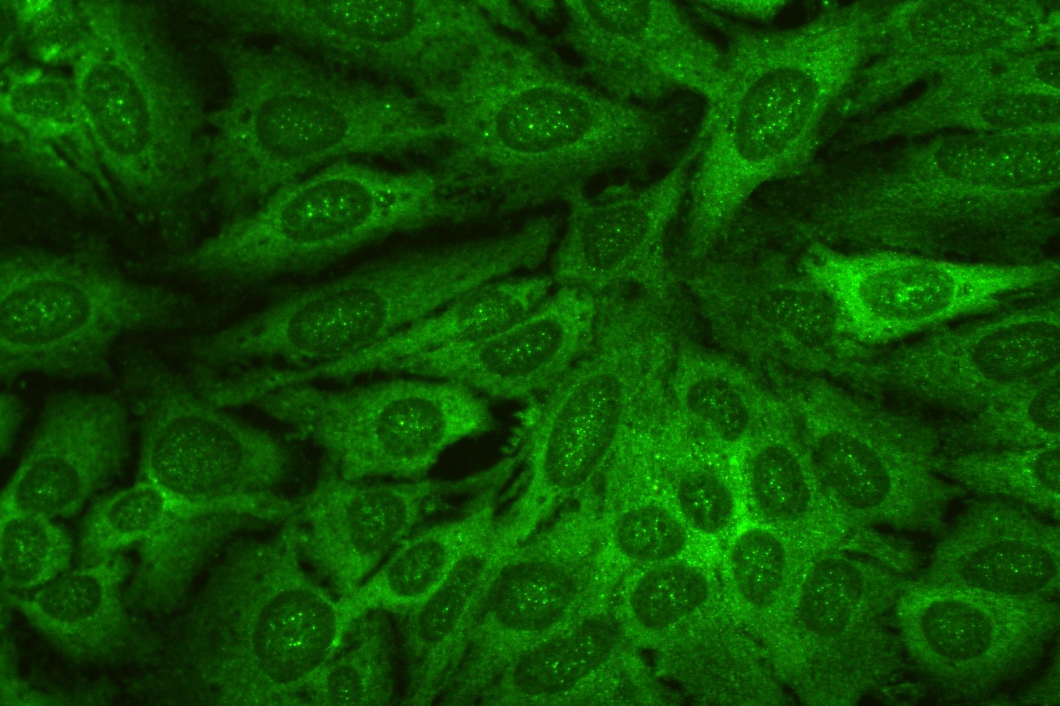
Picture: N. Fabien
Vulsteke et al. submitted

Slide 14
Nineteen complex
Cell division cycle 5-like protein
Pre-mRNA-processing factor 19
Vulsteke et al. Manuscript in preparation

Slide 15
Identified proteins | ID | MW | #1 | #2 | HC1 | HC2
Pre-mRNA-processing factor 19 | PRPF19 | 55 kDa | 1664 | 371 | 315 | 473
Cell division cycle 5-like protein | CDC5L | 92 kDa | 454 | 12 | 9 | 19
Pre-mRNA-splicing factor SPF27 | BCAS2 | 26 kDa | 449 | 64 | 46 | 84
Pleiotropic regulator 1 | PLRG1 | 57 kDa | 218 | 9 | 8 | 6
Heat shock cognate 71 kDa protein | HSPA8 | 71 kDa | 171 | 144 | 113 | 131
U5 small nuclear ribonucleoprotein 200 kDa helicase | SNRNP200 | 245 kDa | 36 | 252 | 18 | 14
116 kDa U5 small nuclear ribonucleoprotein component | EFTUD2 | 109 kDa | 70 | 227 | 42 | 39
Pre-mRNA-processing-splicing factor 8 | PRPF8 | 274 kDa | 45 | 210 | 14 | 27
Pre-mRNA-processing factor 6 | PRPF6 | 107 kDa | 0 | 11 | 0 | 1
PAX3- and PAX7-binding protein 1 | PAXBP1 | 105 kDa | 0 | 164 | 0 | 1
Tuftelin-interacting protein 11 | TFIP11 | 97 kDa | 0 | 90 | 4 | 0
Serine/Arginine-related protein 53 | RSRC1 | 34 kDa | 0 | 60 | 0 | 0
Small nuclear ribonucleoprotein Sm D1 | SNRPD1 | 13 kDa | 55 | 29 | 39 | 49
Small nuclear ribonucleoprotein Sm D2 | SNRPD2 | 14 kDa | 4 | 22 | 2 | 1
Small nuclear ribonucleoprotein Sm D3 | SNRPD3 | 14 kDa | 28 | 55 | 25 | 21
Small nuclear ribonucleoprotein E | SNRPE | 11 kDa | 1 | 15 | 0 | 6
Small nuclear ribonucleoprotein F | SNRPF | 10 kDa | 0 | 7 | 1 | 1
Putative small nuclear ribonucleoprotein G-like protein 15 | SNRPGP15 | 9 kDa | 0 | 5 | 0 | 1
Small nuclear ribonucleoprotein-associated protein | Q5XPV6 | 24 kDa | 7 | 28 | 4 | 9
Nineteen complex
Vulsteke et al. Manuscript in preparation

Slide 16
NE | HC #1 | HC #2 | #1
CDK9 (43 kDa)
Bossuyt et al. Submitted

Slide 17
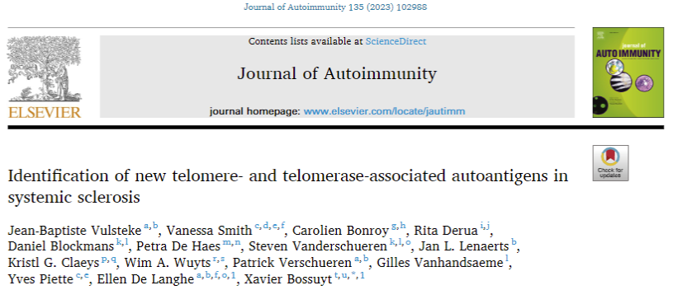

Slide 18
#1 | #2 | #3
THO complex
THOC1, THOC2, THOC3, THOC4, THOC5, THOC6
a complex crucial for telomere maintenance / replication
part of mRNA-exporting TREX complex (transports mRNA to the cytoplasm)

Slide 19
#4 | #5
HMBOX1
Homebox-containing protein 1
Binds directly to 5'-TTAGGG-3' repeats in telomeric DNA. Associates with the telomerase complex at sites of active telomere processing and positively regulates telomere elongation. Important for TERT binding to chromatin, indicating a role in recruitment of the telomerase complex to telomeres
TERF2
TERF2IP
Telomeric repeat-binding factor 2
TERF2 interacting protein
Binds the telomeric double-stranded 5'-TTAGGG-3' repeat and plays a central role in telomere maintenance and protection against end-to-end fusion of chromosomes. Component of the shelterin complex (telosome) that is involved in the regulation of telomere length and protection. Shelterin associates with arrays of double-stranded 5'-TTAGGG-3' repeats added by telomerase and protects chromosome ends; without its protective activity, telomeres are no longer hidden from the DNA damage surveillance and chromosome ends are inappropriately processed by DNA repair pathways.

Slide 20
#7
RCC1
Regulator of chromosome condensation
Involved in the regulation of onset of chromosome condensation in the S phase (PubMed:3678831).
Binds both to the nucleosomes and double-stranded DNA

Slide 21
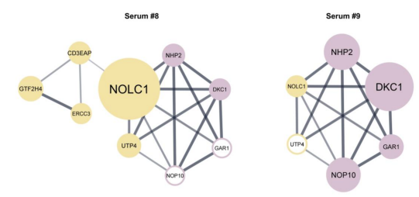
NOLC1
Nucleolar and coiled-body phosphorylation
Interacts with TERF2 and involved in telomere assembly
Regulator of RNA polymerase I
Involved in nucleologenesis
H/ACA ribonucleoprotein complex
Subunit DKC, subunit 1, 2, 3
Involved in ribosome biogenesis
Part of telomerase holoenzyme

Slide 22
#10 | #11 | #12
NOP2
Probable 28S rRNA (cytosine (4447)-C (5)-methyltransferase
Binds directly to telomerase RNA component
NVL
Nuclear valosin-containg protein-like
Participates in the assembly of the telomerase holoenzyme and effecting of telomerase activity via its interaction with TERT
Replication protein A
Essential for telomere replication

Slide 24
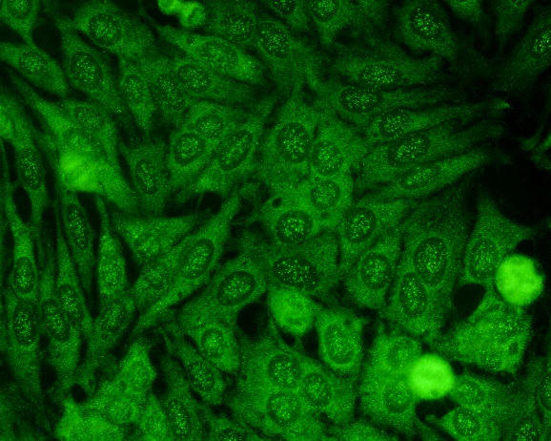
Anti-Ly
Clinical phenotype: seronegative anti-synthetase syndrome
Negative for anti-synthetase Abs by dot blot assays from Euroimmun and D-Tek
 | IP
LC | HC | Anti-Jo-1 | Anti-Ly/Le
CARS1 84 kDa Cysteine-tRNA ligase
Nicole Fabien, Frédéric Coutant, David Goncalves

Slide 25
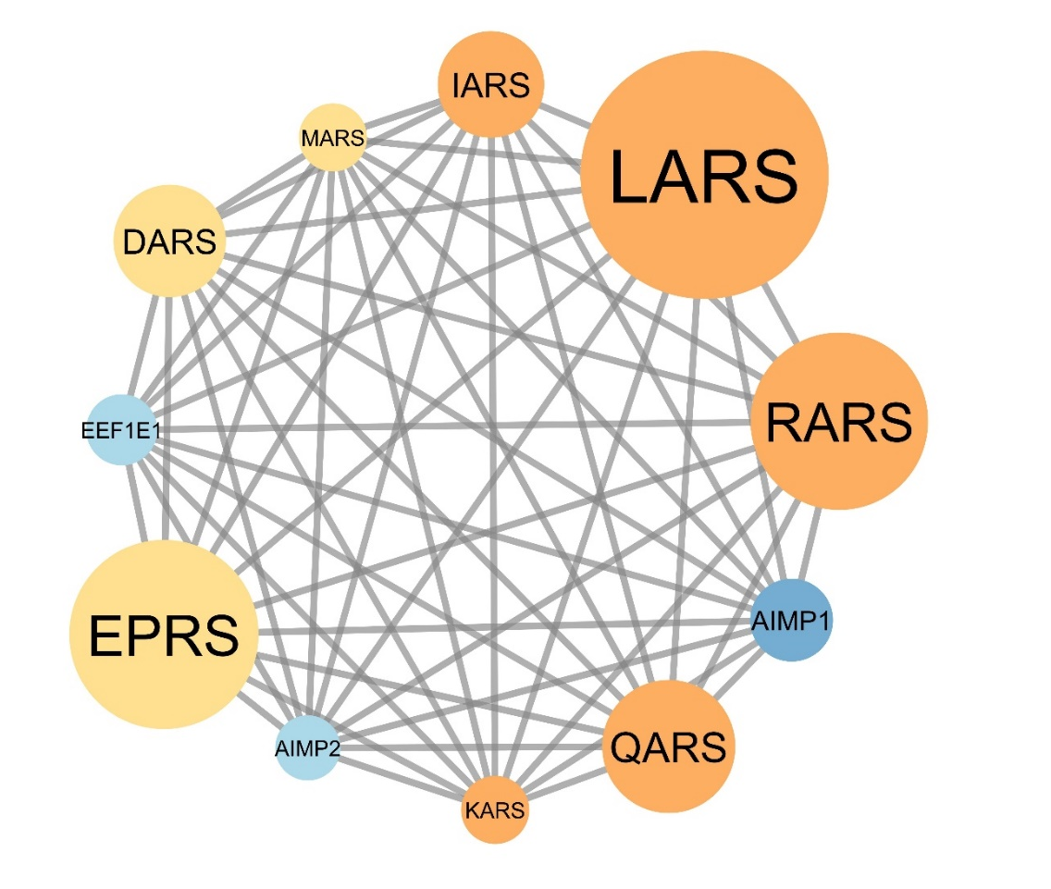
Anti-OJ
Clinical phenotype: seronegative anti-synthetase syndrome
Negative for anti-synthetase Abs by dot blot assays from Euroimmun
IARS isoleucine-tRNA synthetase
LARS leucine-tRNA synthetase
RARS arginine-tRNA synthetase
QARS glutamine-tRNA synthetase
KARS lysine-tRNA synthetase
DARS asparatate-tRNA synthetase
MARS methionine-tRNA synthetase
AIMP1/2 aminoacyl tRNA synthase interacting multifunctional protein 1/2
EPRS Bifunctional glutamate/proline—tRNA synthetase
EEF 1E1 eukaryotic translation elongation factor 1 epsilon 1
Sylvain Dubucquoi, Sébastien Sanges

Slide 26
Goal = creating a multiplex test to detect all aminoacyl-tRNA synthetases
Aminoacyl-tRNA synthetase | AA | Autoantistof
HARS | Histidine | Jo-1
TARS | Threonine | PL-7
AARS | Alanine | PL-12
GARS | Glycine | EJ
IARS | Isoleucine | OJ
NARS | Asparagine | KS
FARS | Phenylalanine | Zo
YARS | Tyrosine | YRS/Ha
Sequence HARS
MAER AALEELVK LQGER VR GLK QQK ASAELIEEEVAK LLK LK AQLGPDESK QK FVLK TPK GTR DYSPR QMAVR EK VFDVIIR CFK R HGAEVIDTPVFELK ETLMGK YGEDSK LIYDLK DQGGELLSLR YDLTVPFAR YLAMNK LTNIK R YHIAK VYR R DNPAMTR GR YR EFYQCDFDIAGNFDPMIPDAECLK IMCEILSSLQIGDFLVK VNDR R ILDGMFAICGVSDSK FR TICSSVDK LDK VSWEEVK NEMVGEK GLAPEVADR IGDYVQQHGGVSLVEQLLQDPK LSQNK QALEGLGDLK LLFEYLTLFGIDDK ISFDLSLAR GLDYYTGVIYEAVLLQTPAQAGEEPLGVGSVAAGGR YDGLVGMFDPK GR K VPCVGLSIGVER IFSIVEQR LEALEEK IR TTETQVLVASAQK K LLEER LK LVSELWDAGIK AELLYK K NPK LLNQLQYCEEAGIPLVAIIGEQELK DGVIK LR SVTSR EEVDVR R EDLVEEIK R R TGQPLCIC
Notes:
Alle ASYS zijn getoond → focus eerst op HARS
Seq HARS + na cleavage met trypsin
Peptiden gekozen op basis van unbiased MS + databases zijn aangeduid

Slide 27
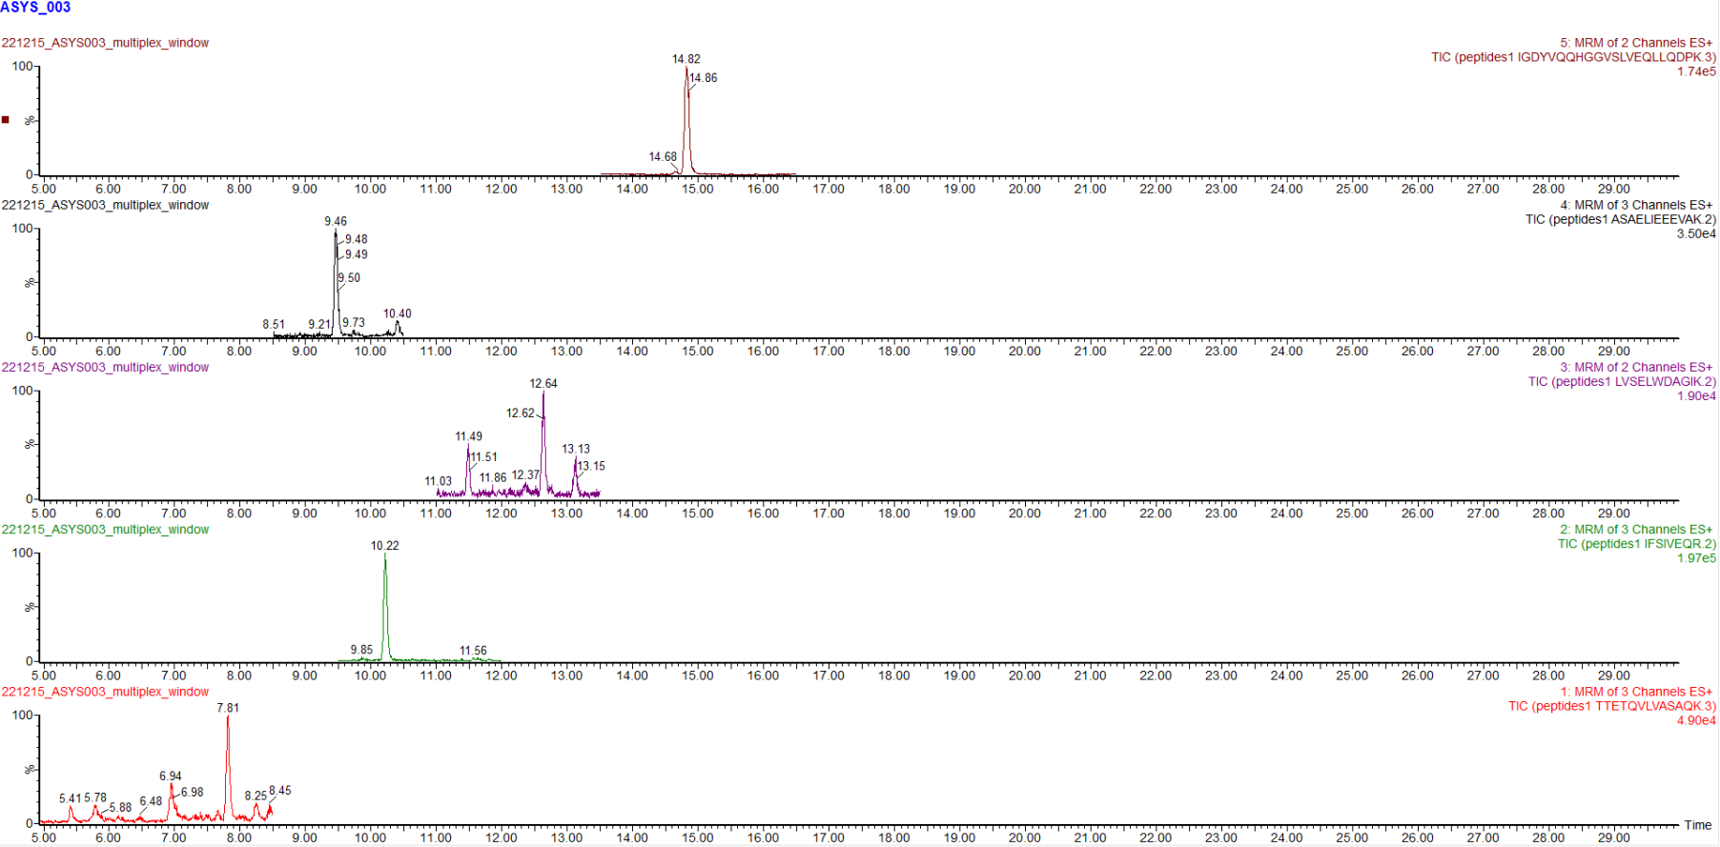
Multiplex of 5 putative HARS peptides
Positive sample: ASYS_003

Slide 28
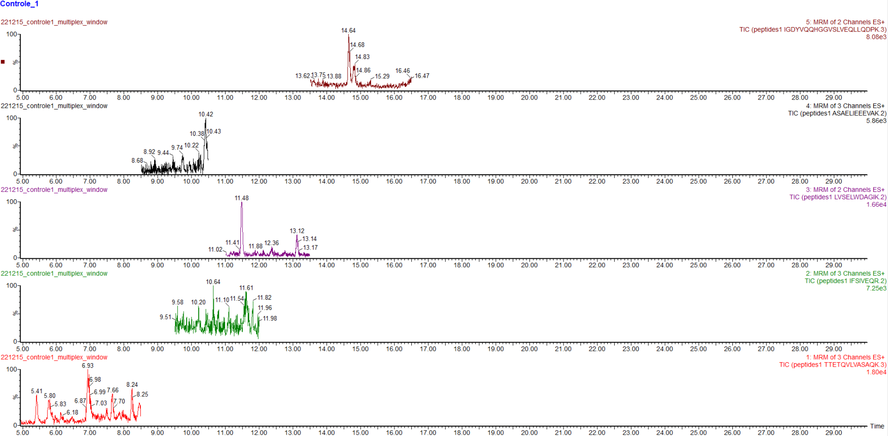
Multiplex of 5 putative HARS peptides
Control sample 1

Slide 29
Peak intensities MRM multiplex
Proteotypic peptides of HARS | Retention time (minutes)
ASAELIEEEVAK | 9,47 – 9,49
IGDYVQQHGGVSLVEQLLQDPK | 14,83 – 14,84
TTETQVLVASAQK | 7,81 – 7,83
IFSIVEQR | 10,22 – 10,24
LVSELWDAGIK | 12,65 – 12,66

Slide 30
Thibaut Belmondo, Sophie Hüe
Anti-proteasome activator 28γ (Ki)
Ki-P1
Ki-P2
Ki-P3
Discoid LE / sickle cell disease Antiphospholipid syndrome RA and Sjögren
RNP70-U1RNP
Speckled, 1/1280
Fine speckled, 1/1280
Speckled, 1/80
Fine speckled, 1/2560

