Slide 1
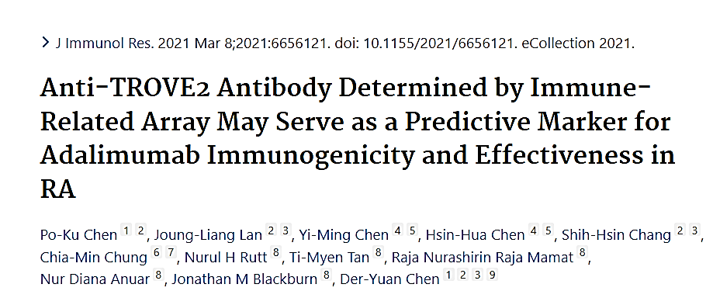

Slide 2
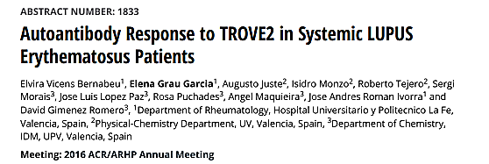


Slide 3
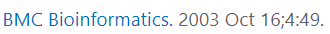
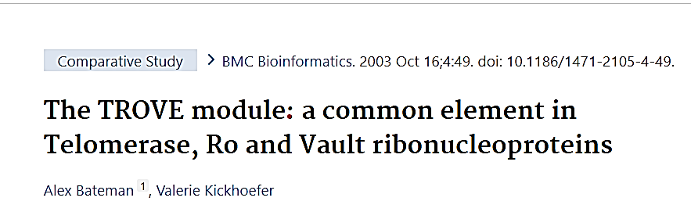
TROVE MODULE
RNA BINDING MOTIF
RIBONUCLEOPROTEINS
TELOMERASE RNA TEP1 TROVE1 PROTEIN
Ro YRNA (Rose) Ro60 TROVE2
Vault RNA (VtRNA) MVP PROTEIN/TEP1

Slide 4
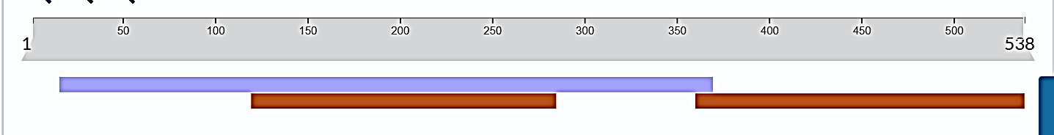
TROVE2 ANTIBODIES
SSA/Ro 60
TROVE DOMAIN
RNA BINDING
Ab

Slide 5
AUTOANTIBODIES
PL7 ThrRS
PL12 AlaRS
EJ GlyRS
OJ IleRS
KS AsnRS
Zo PheRS
Ha TyrRS
Sc LysRS
JS GlnRS
WARS TrpRS
SSA/Ro60 TROVE2
Ro52 TRIM21
NXP2 MORC3
TIF1ϒ TRIM33
Ku XRCC
Mi2α CHD3
Mi2β CHD4
JO1 HisRS

Slide 6

ANTI-NXP2 ANTIBODIES
ANTI-MJ
ANTIBODIES TO A 140 kDa ANTIGEN
ANTI-NXP2
ANTI-NUCLEAR MATRIX 2
ANTI-MORC3

